Slide 1
Halifax Explosion
6 December 1917

Slide 2
Halifax Explosion
A maritime disaster in Halifax, Nova Scotia, Canada
Morning of 6 December 1917.
The Norwegian vessel SS Imo collided with SS Mont-Blanc, a French cargo ship laden with high explosives.
This resulted in a large explosion on the French freighter, which devastating the Richmond district of Halifax.
Approximately 2,000 people were killed by the blast, debris, fires or collapsed buildings, and an estimated 9,000 others were injured.
The blast was the largest man-made explosion at the time, releasing the equivalent energy of roughly 2.9 kilotons of TNT (12,000 GJ).
Notes:
Largest artificial explosion at the time, and remained the largest until the trinity test.

Slide 3
Largest Conventional Explosions
Event | Location | Date | Approximate yield
Minor Scale and Misty Picture tests | White Sands Missile Range | 27 June 1985; 14 May 1987 | 4.0 kt of TNT (17 TJ)
Heligoland/British Bang test | Heligoland island | 18 April 1947 | 3.2 kt of TNT (13 TJ)
Halifax Explosion | Halifax, Nova Scotia | 6 December 1917 | 2.9 kt of TNT (12 TJ)
Texas City disaster | Texas City, Texas | 16 April 1947 | 2.7–3.2 kt of TNT (11–13 TJ)
Evangelos Florakis Naval Base explosion | Evangelos Florakis Naval Base, Cyprus | 11 July 2011 | 2–3.2 kt of TNT (9–13 TJ)
RAF Fauld Explosion | Staffordshire, UK | 27 November 1944 | 2 kt (8.4 TJ)
Port Chicago disaster | Port Chicago, California | 17 July 1944 | 1.6–2.2 kt of TNT (7–9 TJ)
Oppau explosion | Oppau, Ludwigshafen, Germany | 21 September 1921 | 1–2 kt of TNT (4-8 TJ)
N1 launch explosion | Baikonur Cosmodrome Site 110 | 3 July 1969 | 1 kt of TNT (4 TJ)
Notes:
The trinity test was nuclear - the Halifax explosion is still one of the largest artifical non-nuclear explosions to date

Slide 4
Nuclear explosions
Date | Name | Yield (kt) | Country | Significance
1945-07-16 | Trinity | 18–20 | USA | First fission device test, first plutonium implosion detonation
1945-08-06 | Little Boy | 12–18 | USA | Bombing of Hiroshima, Japan, first detonation of a uranium gun-type device, first use of a nuclear device in combat.
1945-08-09 | Fat Man | 18–23 | USA | Bombing of Nagasaki, Japan, second detonation of a plutonium implosion device (the first being the Trinity Test), second and last use of a nuclear device in combat.
1949-08-29 | RDS-1 | 22 | USSR | First fission weapon test by the USSR
1952-10-03 | Hurricane | 25 | UK | First fission weapon test by the UK
1952-11-01 | Ivy Mike | 10,400 | USA | First cryogenic fusion fuel "staged" thermonuclear weapon, primarily a test device and not weaponized
1952-11-16 | Ivy King | 500 | USA | Largest pure-fission weapon ever tested
1953-08-12 | Joe 4 | 400 | USSR | First fusion weapon test by the USSR (not "staged")
1954-03-01 | Castle Bravo | 15,000 | USA | First dry fusion fuel "staged" thermonuclear weapon; a serious nuclear fallout accident occurred; largest nuclear detonation conducted by United States
1955-11-22 | RDS-37 | 1,600 | USSR | First "staged" thermonuclear weapon test by the USSR (deployable)
1957-05-31 | Orange Herald | 720 | UK | Largest boosted fission weapon ever tested. Intended as a fallback "in megaton range" in case British thermonuclear development failed.
1957-11-08 | Grapple X | 1,800 | UK | First (successful) "staged" thermonuclear weapon test by the UK
1960-02-13 | Gerboise Bleue | 70 | France | First fission weapon test by France
1961-10-31 | Tsar Bomba | 50,000 | USSR | Largest thermonuclear weapon ever tested—scaled down from its initial 100 Mt design by 50%
1964-10-16 | 596 | 22 | PR China | First fission weapon test by the People's Republic of China
1967-06-17 | Test No. 6 | 3,300 | PR China | First "staged" thermonuclear weapon test by the People's Republic of China
1968-08-24 | Canopus | 2,600 | France | First "staged" thermonuclear weapon test by France
1974-05-18 | Smiling Buddha | 12 | India | First fission nuclear explosive test by India
1998-05-11 | Pokhran-II | 45–50 | India | First potential fusion/boosted weapon test by India; first deployable fission weapon test by India
1998-05-28 | Chagai-I | 40^{[11]} | Pakistan | First fission weapon (boosted) test by Pakistan
2006-10-09 | 2006 North Korean nuclear test | under 1 | North Korea | First fission weapon test by North Korea (plutonium-based)
2017-09-03 | 2017 North Korean nuclear test | 200–300 | North Korea | First "staged" thermonuclear weapon test claimed by North Korea
Notes:
But the Halifax explosion test was still much smaller than even early nuclear tests.

Slide 6
Francis Mackey, the captain of the Mont-Blanc had asked about "special protections" such as a guard ship, given the Mont-Blanc's cargo, but no protections were put in place.
Mont-Blanc started moving at 7:30 am on 6 December and was the second ship to enter the harbour as the anti-submarine net between Georges Island and Pier 21 opened for the morning.
Mont-Blanc headed towards Bedford Basin on the Dartmouth side of the harbour. He first spotted Imo when she was about 0.75 miles away and became concerned as her path appeared to be heading towards his ship's starboard side, as if to cut him off.
Mackey gave a short blast of his ship's signal whistle to indicate that he had the right of way but was met with two short blasts from Imo, indicating that the approaching vessel would not yield its position.
The captain ordered Mont-Blanc to halt her engines and angle slightly to starboard, closer to the Dartmouth side of the Narrows. He let out another single blast of his whistle, hoping the other vessel would likewise move to starboard but was again met with a double-blast.

Slide 7
Both ships had cut their engines by this point, but their momentum carried them right on top of each other at slow speed. Unable to ground his ship for fear of a shock that would set off his explosive cargo, Mackey ordered Mont-Blanc to steer hard to port and crossed the bow of Imo in a last-second bid to avoid a collision. The two ships were almost parallel to each other, when Imo suddenly sent out three signal blasts, indicating the ship was reversing its engines. The combination of the cargoless ship's height in the water and the transverse thrust of her right-hand propeller caused the ship's head to swing into Mont-Blanc. Imo's prow pushed into the hold of Mont Blanc.
The damage to Mont Blanc was not severe, but barrels of deck cargo toppled and broke open. This flooded the deck with benzol that quickly flowed into the hold.
As Imo's engines kicked in, she disengaged, which created sparks inside Mont-Blanc's hull. These ignited the vapours from the benzol. A fire started at the water line and travelled quickly up the side of the ship.

Slide 8
At 9:04:35 am the out-of-control fire on board Mont-Blanc set off her cargo of high explosives. The ship was completely blown apart and a powerful blast wave radiated away from the explosion at more than 1km/s.
Temperatures of 5,000 °C and pressures of thousands of atmospheres accompanied the moment of detonation at the centre of the explosion.
Mont-Blanc's forward 90-mm gun landed approximately 5.6km north of the explosion site .
Mont-Blanc's anchor, weighing half a ton, landed 3.2km south.

Slide 10
Nearly all structures within an 800-metre (half-mile) radius, including the community of Richmond, were obliterated.

Slide 12
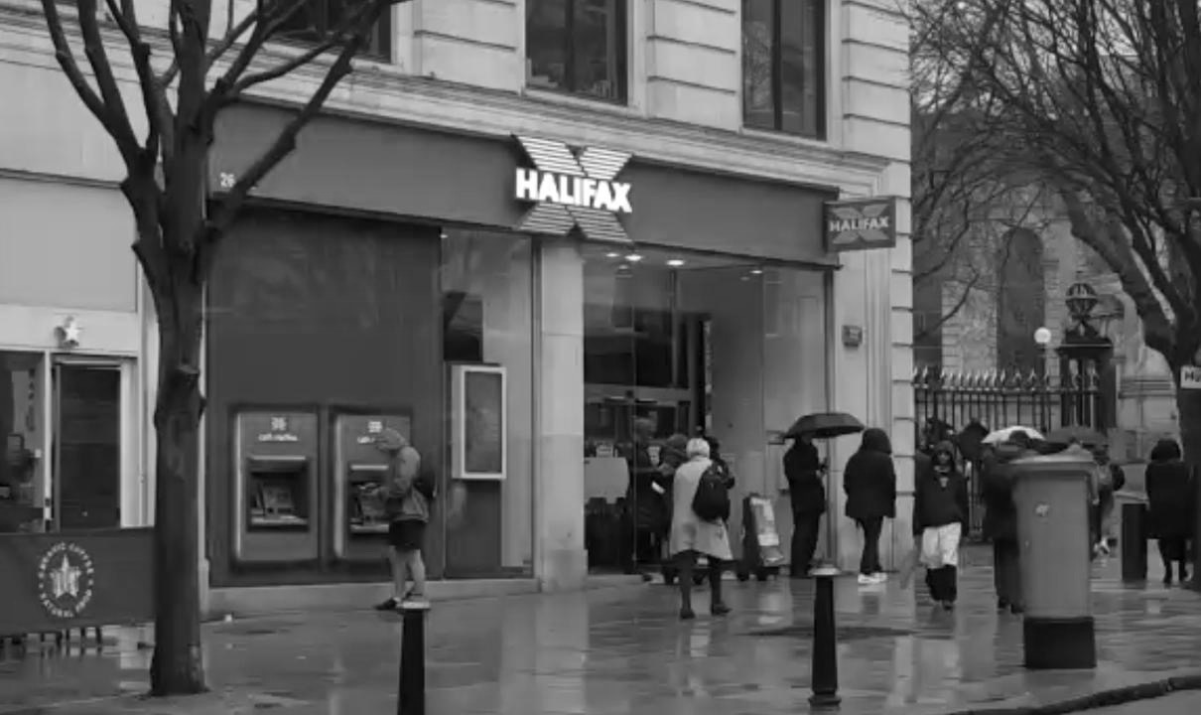

Slide 14
Destruction and loss of life
The exact number killed by the disaster is unknown. An official database compiled in 2002 by the Nova Scotia Archives and Records Management, identified 1,950 victims. As many as 1,600 people died immediately in the blast, tsunami, and collapse of buildings. The last body, a caretaker killed at the Exhibition Grounds, was not recovered until the summer of 1919.
An additional 9,000 were injured, 1630 homes destroyed in the explosion and fires, and another 12,000 damaged. Roughly 6,000 people were left homeless and 25,000 had insufficient shelter. The city's industrial sector was in large part gone, with many workers among the casualties and the dockyard heavily damaged.

Slide 15
Legacy
The Halifax Explosion was one of the largest artificial non-nuclear explosions. An extensive comparison of 130 major explosions by Halifax historian Jay White in 1994 concluded that "Halifax Harbour remains unchallenged in overall magnitude as long as five criteria are considered together: number of casualties, force of blast, radius of devastation, quantity of explosive material, and total value of property destroyed.”
For many years afterward, the Halifax Explosion was the standard by which all large blasts were measured. For instance, in its report on the atomic bombing of Hiroshima, Time wrote that the explosive power of the Little Boy bomb was seven times that of the Halifax Explosion.

Slide 16
Legacy
The many eye injuries resulting from the disaster led to better understanding on the part of physicians of how to care for damaged eyes, and "with the recently formed Canadian National Institute for the Blind, Halifax became internationally known as a centre for care for the blind", according to Dalhousie University professor Victoria Allen.
The lack of coordinated pediatric care in such a disaster was also noted by William Ladd, a surgeon from Boston who had arrived to help. His insights from the explosion are generally credited with inspiring him to pioneer the specialty of pediatric surgery in North America. The Halifax Explosion also inspired a series of health reforms, including around public sanitation and maternity care.

